Slide 1

CSA-5109 CRYPTOGRAPHY AND NETWORK SECURITY
Security Attacks, Threats, Risks and Their Impact on Security Goals
Under the Supervision of:
Nithisha J
Presented By:
N.Sai Charan (192525247)
G.Nikhil (192525393)

Slide 2


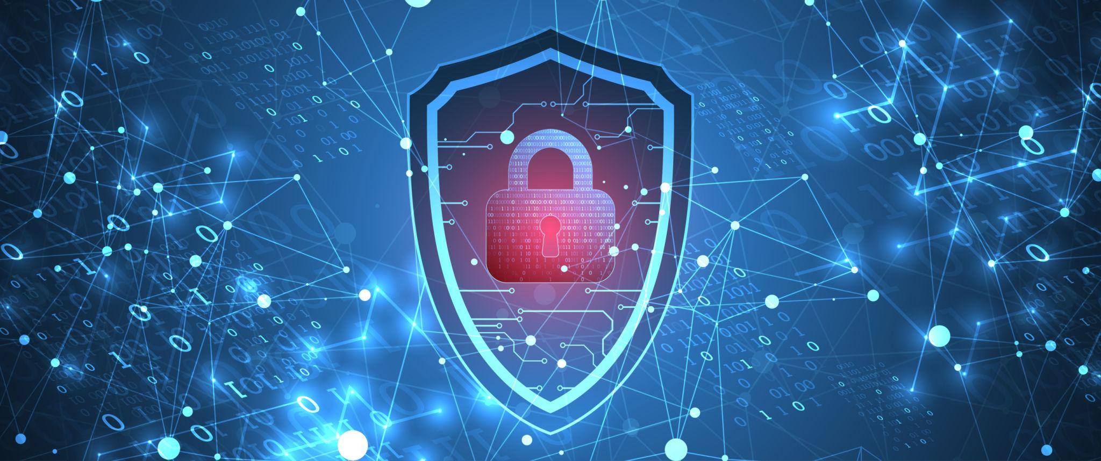
INTRODUCTION
Information Security:
Information security protects data and systems from unauthorized access, modification, or destruction.
Key Concepts:
Threat: A potential cause of harm to an information system.
Attack: An attempt to exploit a vulnerability.
Risk: The possibility of loss when a threat exploits a vulnerability.
Vulnerability: A weakness in a system that can be exploited.
Objective:
Understand how attacks, threats, and risks affect the security of digital information.

Slide 3
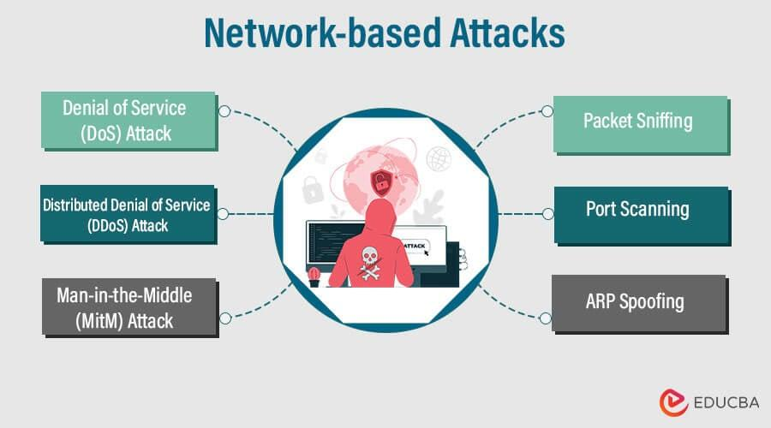
Types of Security Attacks
Passive Attacks:
Monitor or intercept data without altering it.
Difficult to detect.
Examples:
1) Eavesdropping
2)Traffic Analysis
Active Attacks:
Modify, interrupt, or destroy data.
Easier to detect but harder to prevent.
Examples:
Malware
Phishing
Denial-of-Service (DoS)
Man-in-the-Middle (MITM)

Slide 4
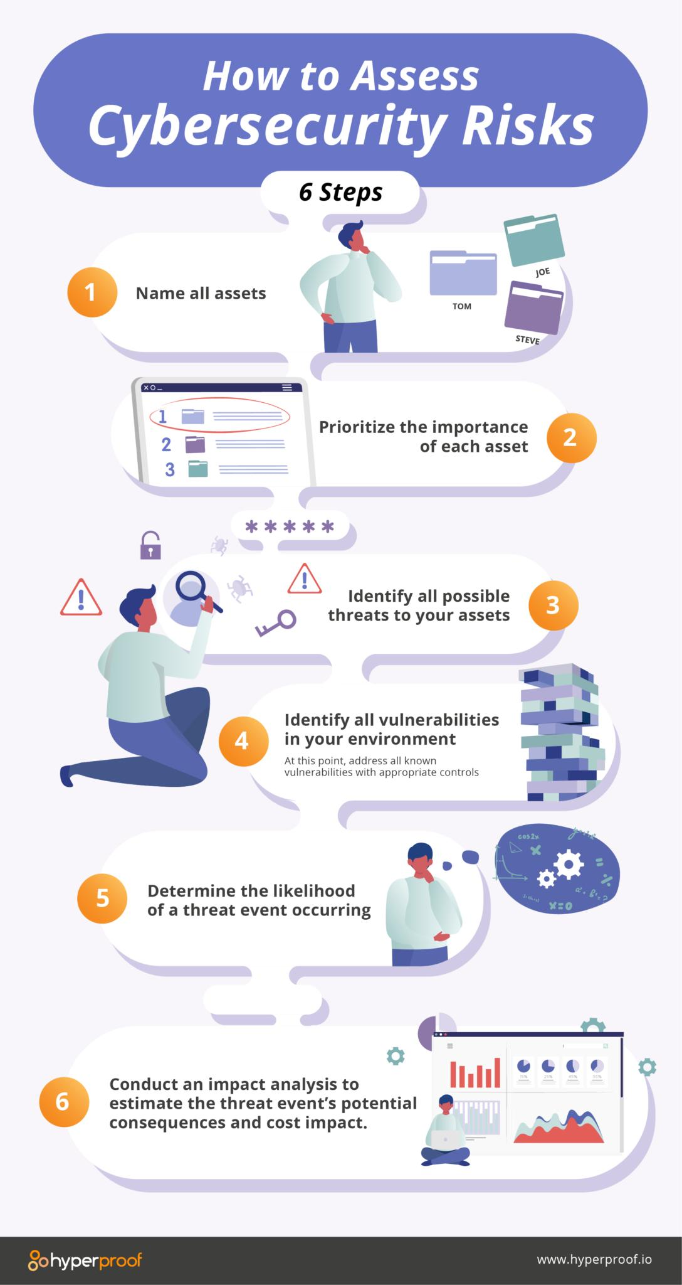
Threats and Risk Assessment
Types of Threats:
Malware (Virus, Worm, Trojan, Ransomware)
Insider Threats
Social Engineering
Natural Disasters
Hardware or Software Failures
Risk Assessment Process:
Identify Assets
Identify Threats
Analyze Vulnerabilities
Estimate Risk Level
Apply Security Controls
Risk Formula:
Risk = Threat × Vulnerability × Impact

Slide 5
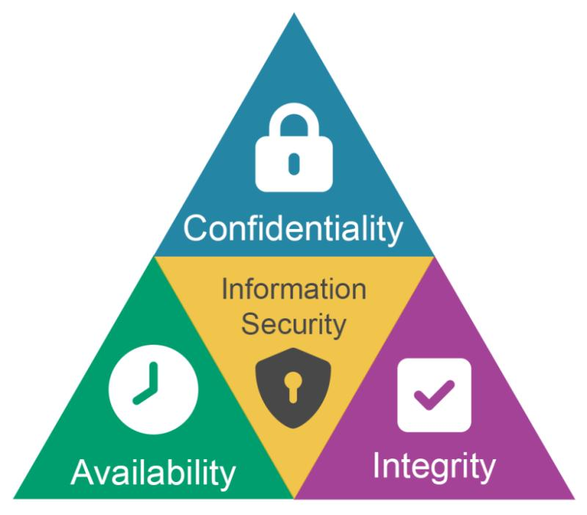
Impact on Security Goals (CIA Triad)
Confidentiality:
Prevents unauthorized access to information.
Example: Encryption, Authentication
Integrity:
Ensures data remains accurate and unaltered.
Example: Hashing, Digital Signatures
Availability:
Ensures systems and data are accessible when needed.
Example: Backups, Firewalls, Redundant Servers
Other Security Goals:
Authentication
Authorization
Non-Repudiation
Accountability

Slide 6
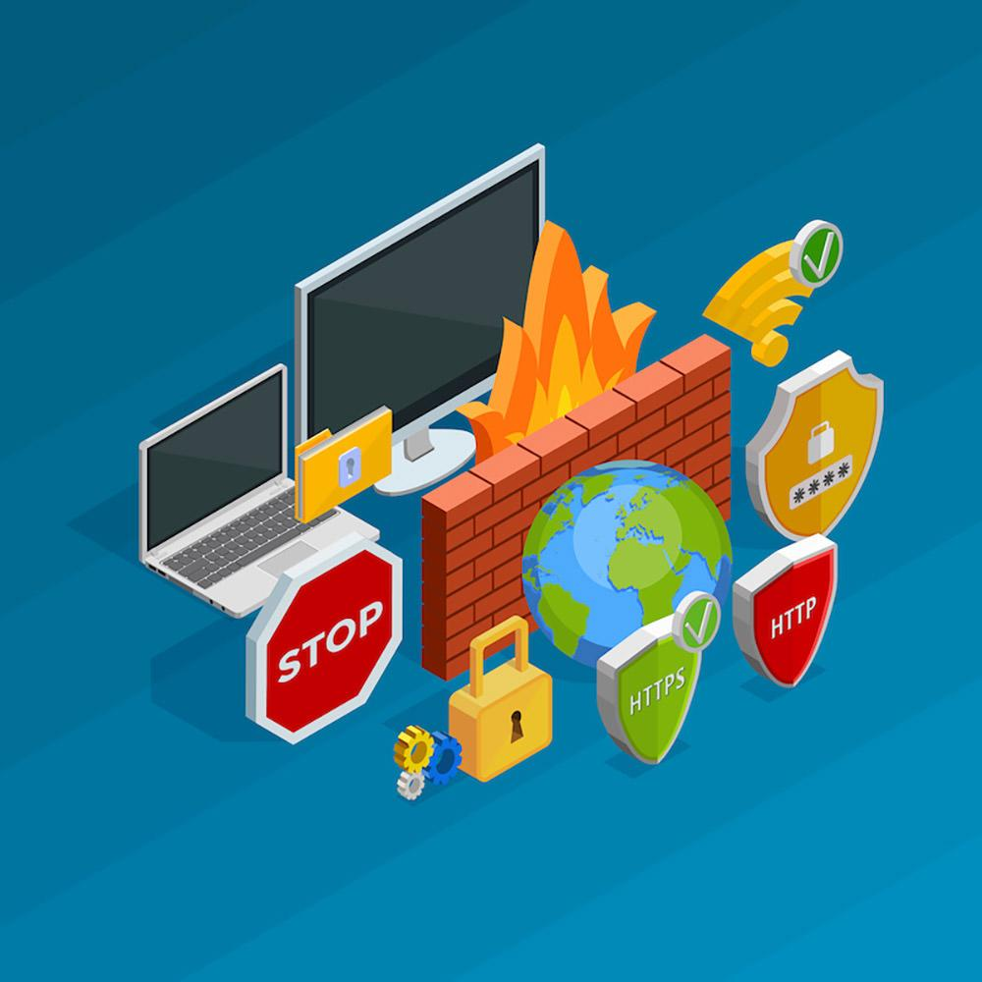
Prevention, Best Practices & Conclusion
Prevention Techniques
Strong Passwords and Multi-Factor Authentication (MFA)
Firewalls and Antivirus Software
Regular Software Updates and Patch Management
Data Encryption
Security Awareness Training
Regular Backups
Intrusion Detection and Prevention Systems (IDS/IPS)
Conclusion:
Security attacks exploit vulnerabilities to compromise systems.
Identifying threats and managing risks helps protect valuable information.
A combination of technology, policies, and user awareness is essential for maintaining information security.

Slide 7
Thank you !

